Slide 1

SCIENCE:
Air Quality Data Science
Middle School

Slide 2
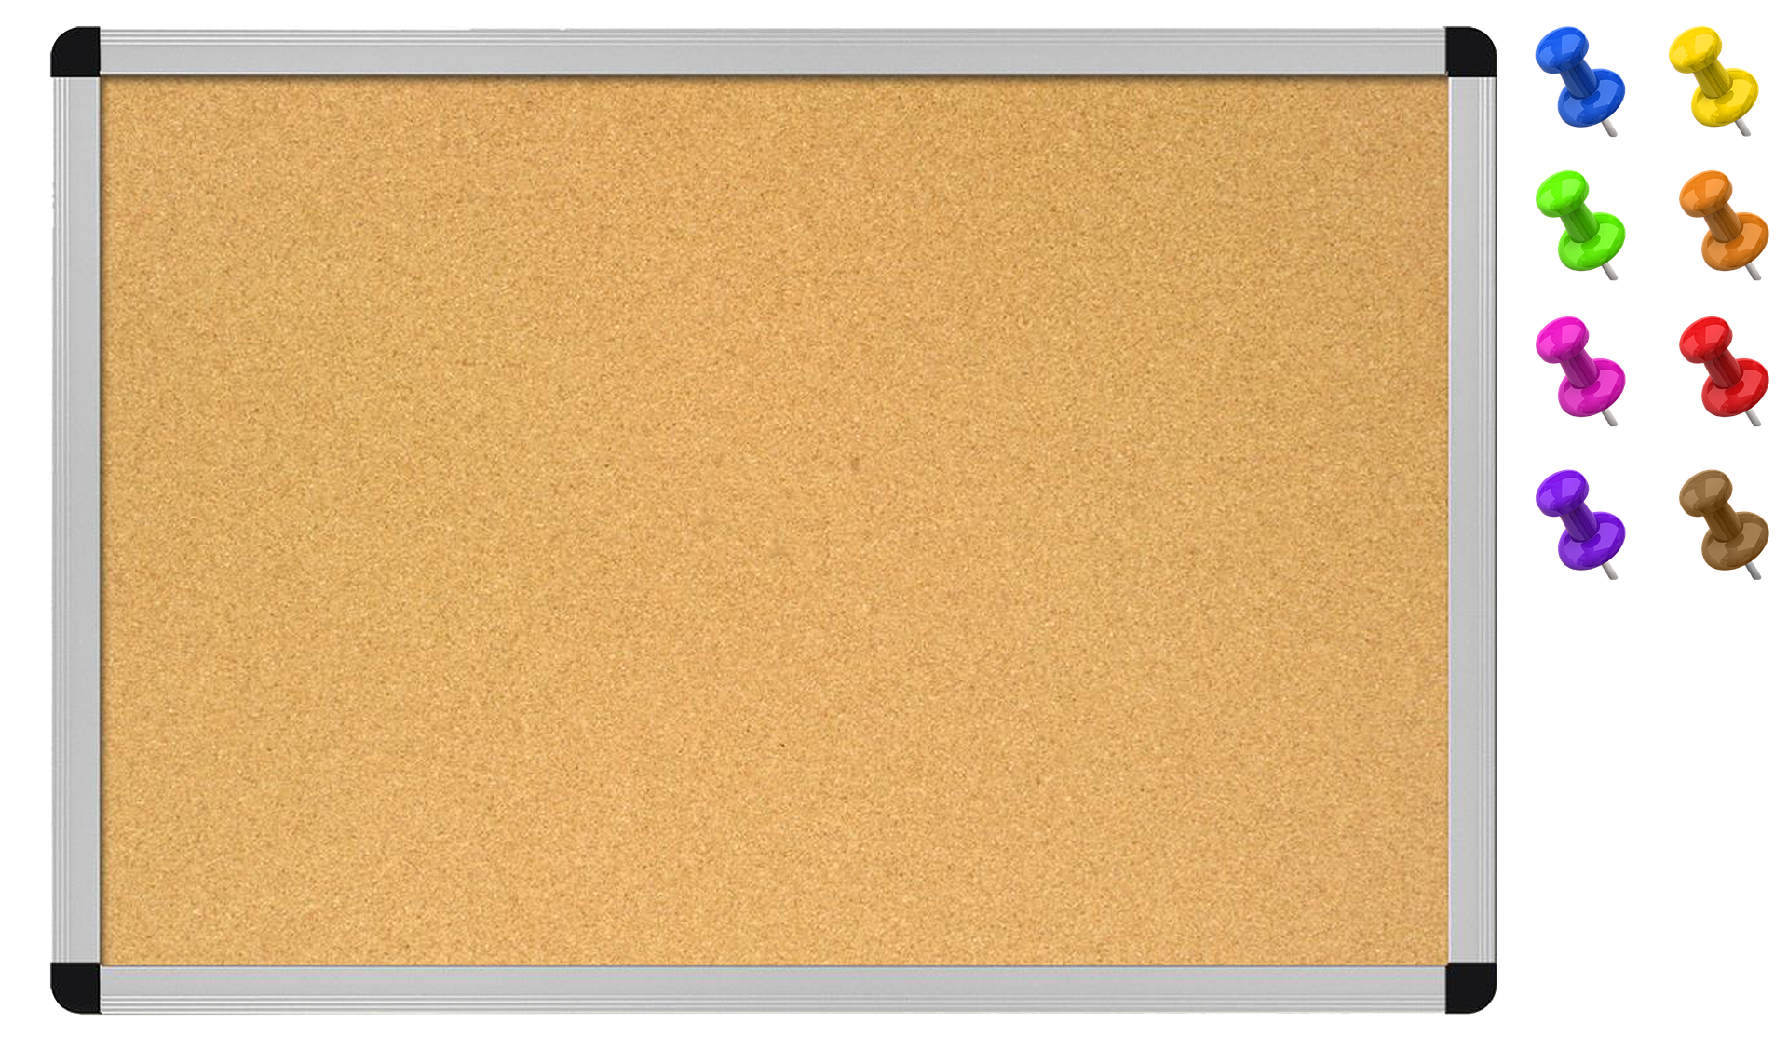



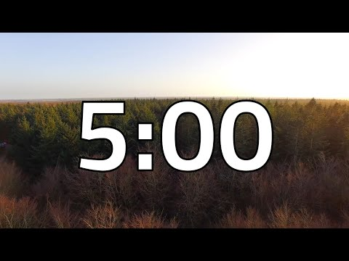





Monday
DAILY AGENDA
Warm Up
Kmart Fire Video
Atmotubes
Warm Up
What is this?
Planner:
Atmotubes
Be Prepared
Sharpened pencil
Notes:
Teacher notes: Quick warm up for students to guess what the zoomed in image is. Edit or delete for use in your classroom.

Slide 3

Pages of a book

Slide 4
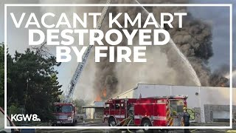
KMart Fire Video
What problems came from the KMart fire in Portland, Oregon?
“One problem is….”
Notes:
https://www.youtube.com/watch?v=VGJW9vEwl90 (1:58 minutes)

Slide 5
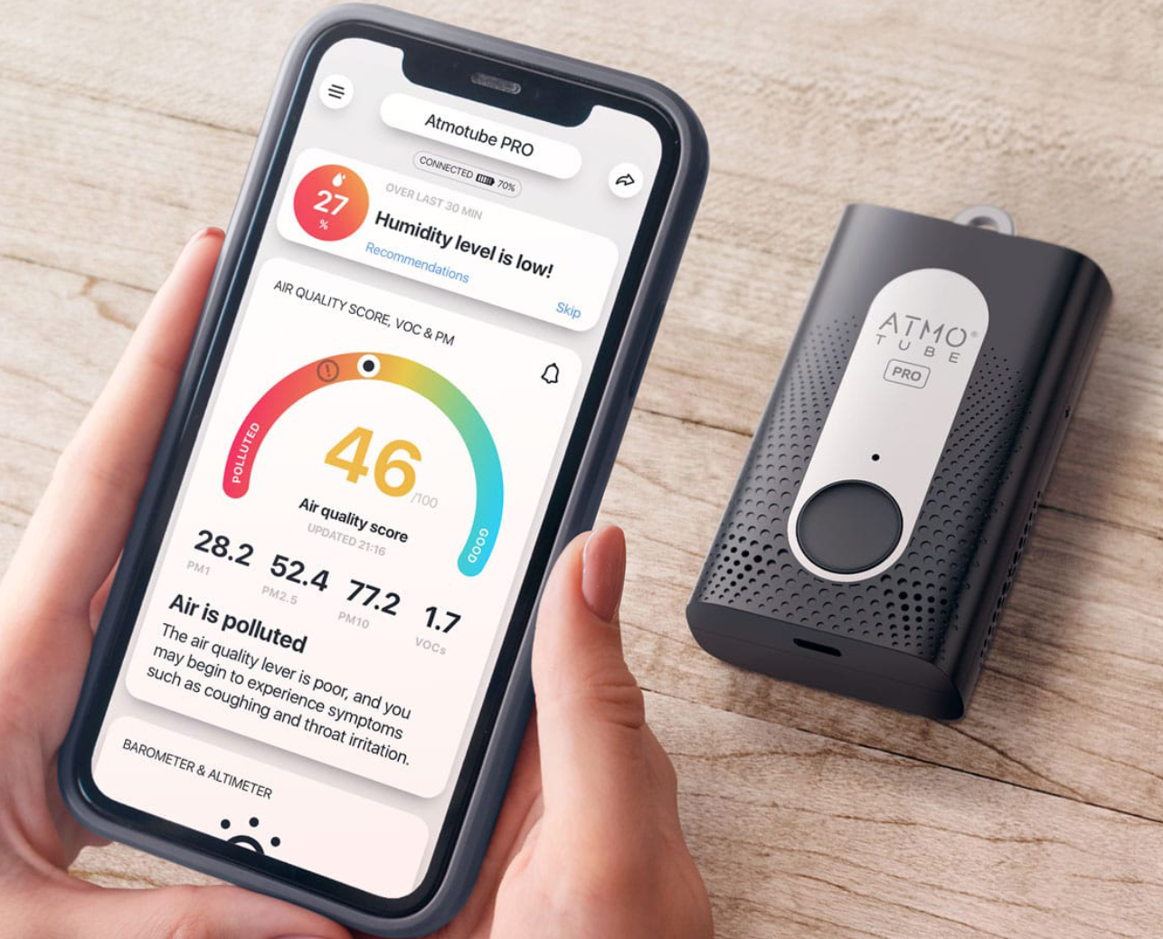
Atmotube
How to use:
Step 1 - Press and hold the black button
Step 2 - Connect to your phone bluetooth
Step 3 - Look at number on the Atmotube App

Slide 6
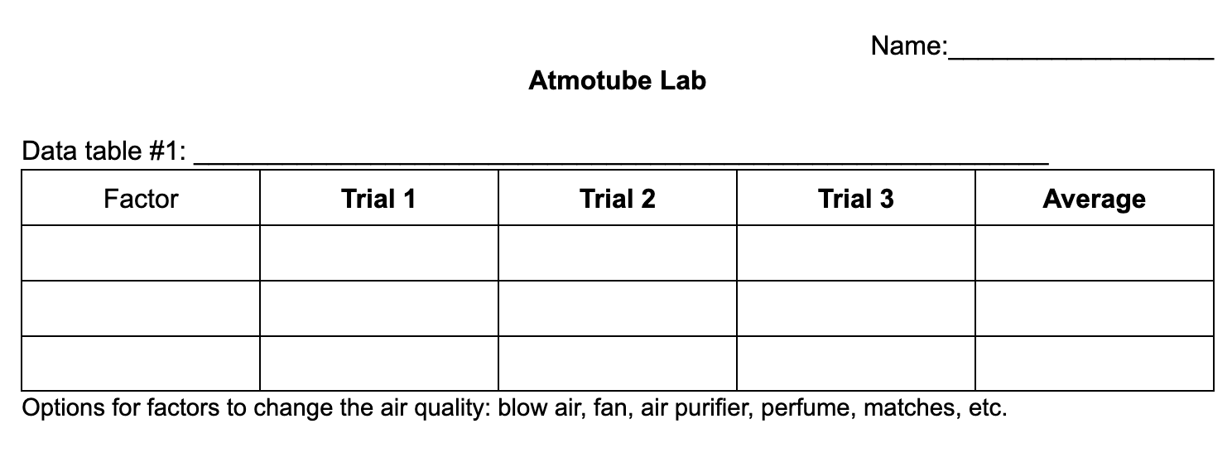
Collect data with your group
Notes:
AQI Atmotube Lab Doc

Slide 7
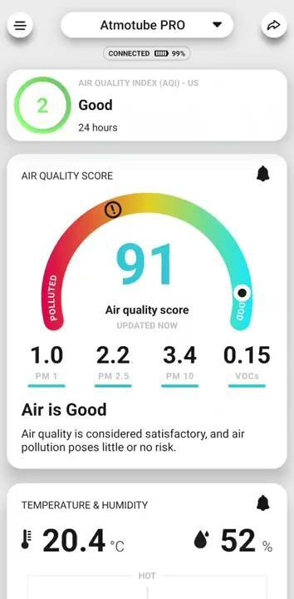
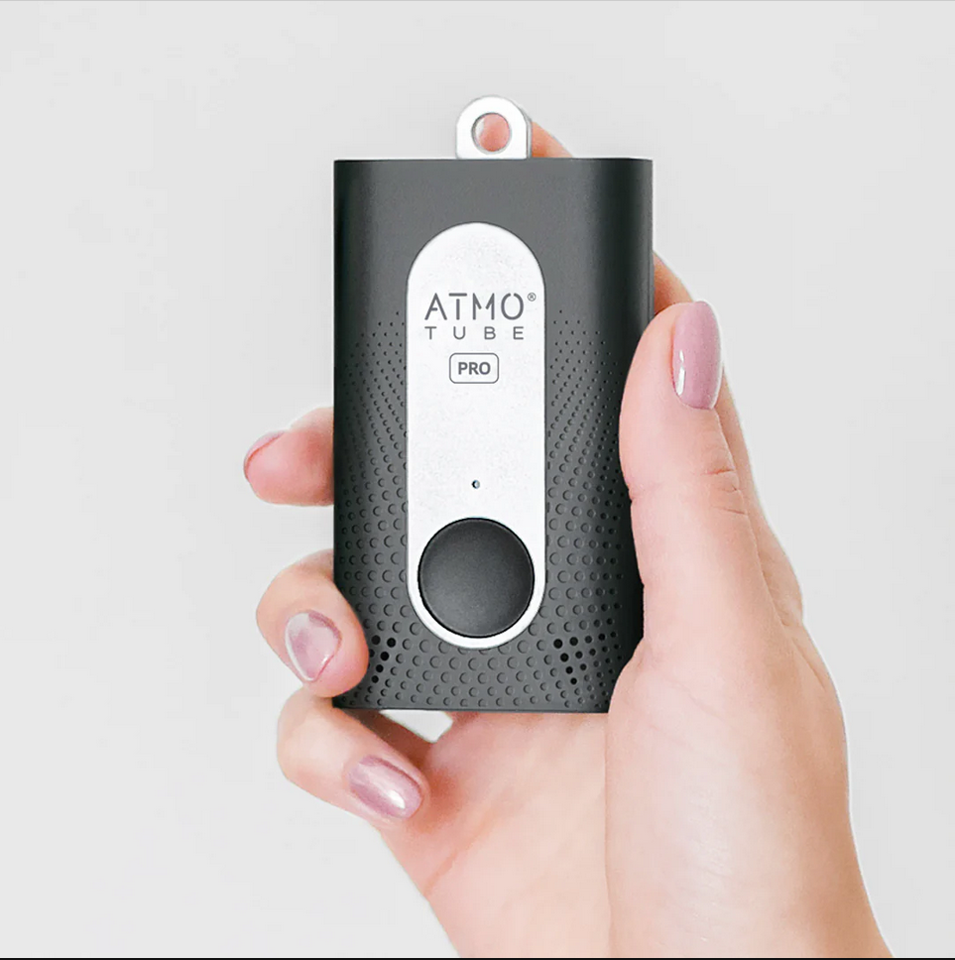
Atmotube Instructions
Download the Atmotube App (latest version).
Allow Atmotube to use your location (spatial data!)
Enable bluetooth
Allow to use GPS data
Notifications? up to you!
Settings: use precise GPS location.
Check out an atmotube from your instructor.
Look on the back side of your device. There is a white sticker with numbers like this:
#10 B9F7 "CD:B2"
When you connect to a device, ALL of the Atmotubes in our classroom will appear in a list. Find yours, and connect to it.
Are you on an Apple device? Search for the underlined number (like B9F7) to connect to your device.
Are you on an Android device? Search for the full serial number (CD:B2:E1:7B: etc.) The first four digits are on the back of your atmotube, (like "CD:B2")
Select your atmotube and hit "connect."
Did something get confused? Walk far away from all other atmotubes. Close and re-open the Atmotube App. If you are out of bluetooth range, only your device will show up.
Notes:
AQI Atmotube Instructions Slide

Slide 8
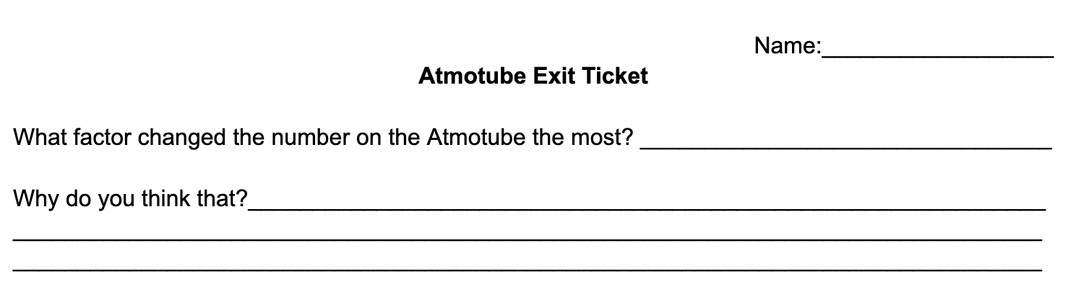
Clean Up and Exit Ticket
Put supplies back where you found them
Return Atmotube
Notes:
AQI Atmotube Exit Ticket

Slide 9
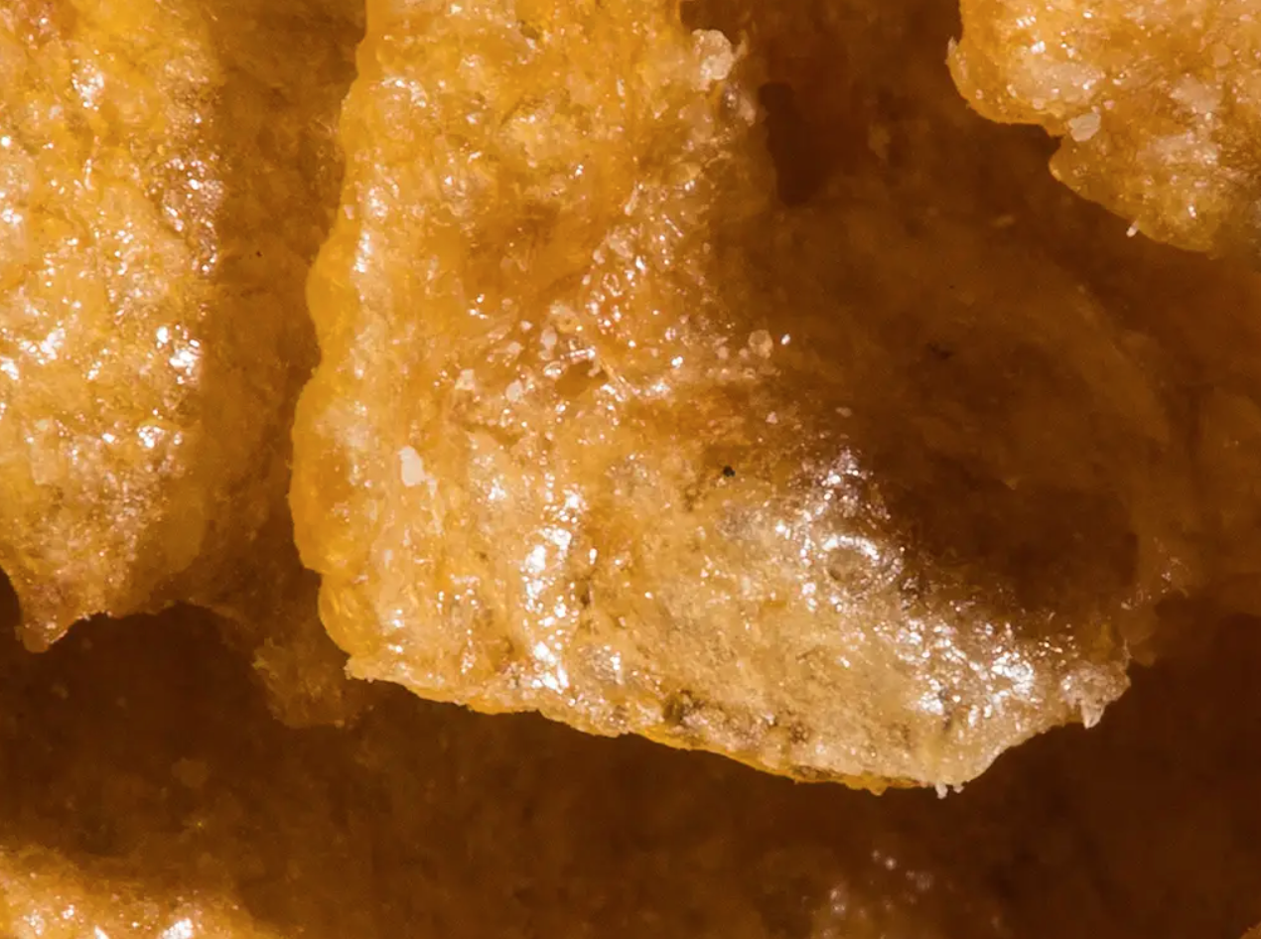
Tuesday
DAILY AGENDA
Warm Up
Plot graphs
Video
Data science
Warm Up
What is this?
Planner:
AQI
Be Prepared
Sharpened pencil

Slide 10
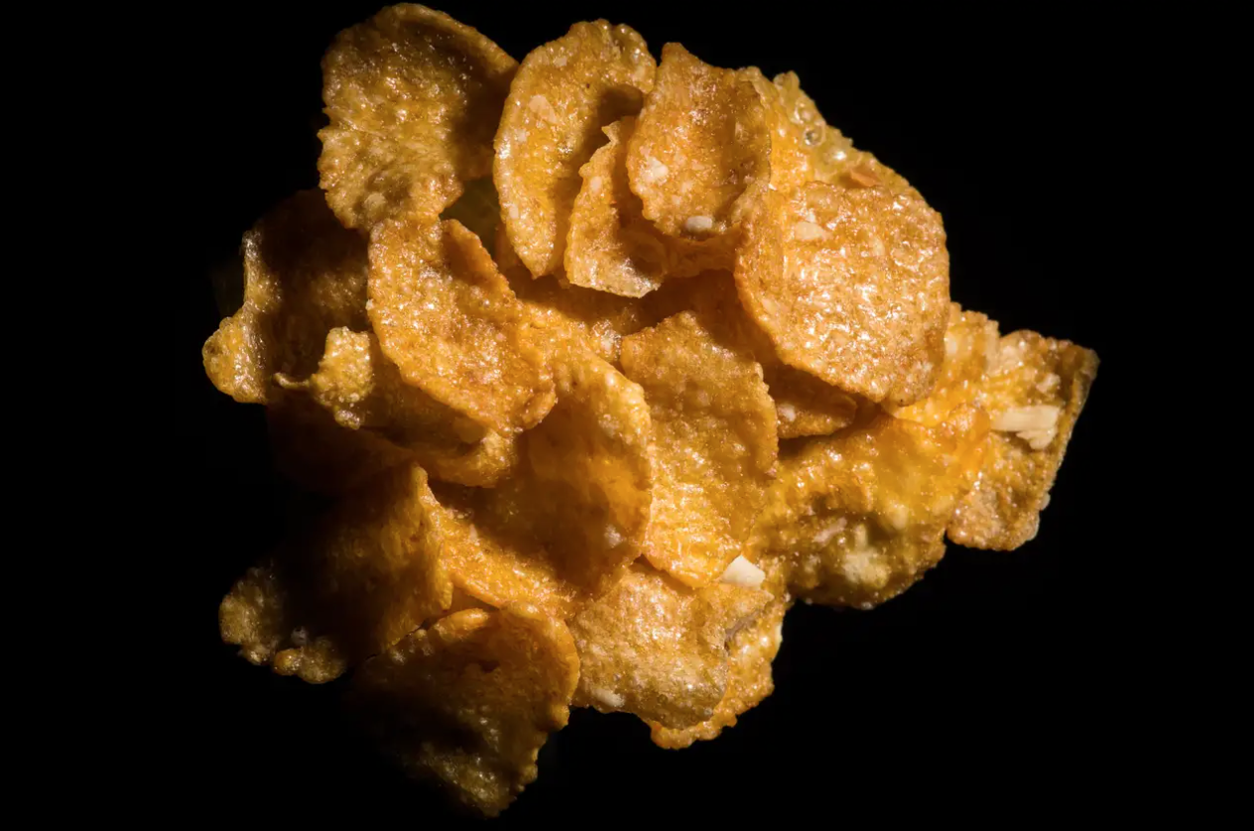
Flakes of cereal

Slide 11
Atmotube
What factors changed the air quality number on the Atmotubes the most?
“ The factor that changed the air quality the most was_______”

Slide 12

What factors change air quality outside?
“One factor that changes air quality is…
Notes:
Example answers: smoke, cars, pollution, volcanoes, gas leak, etc.

Slide 13
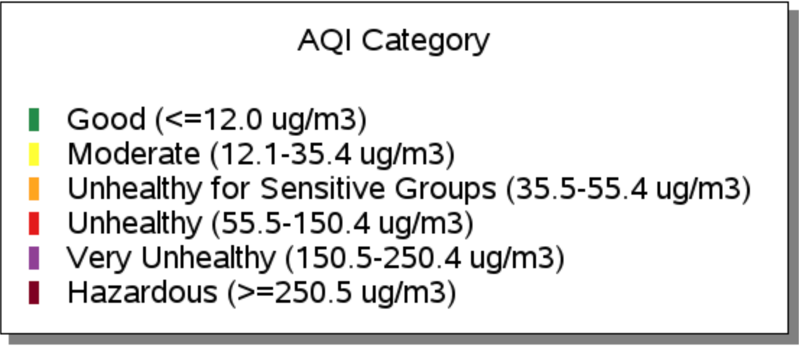
AQI Graphs
What does the color mean?
Notes:
EPA AQI Data

Slide 14
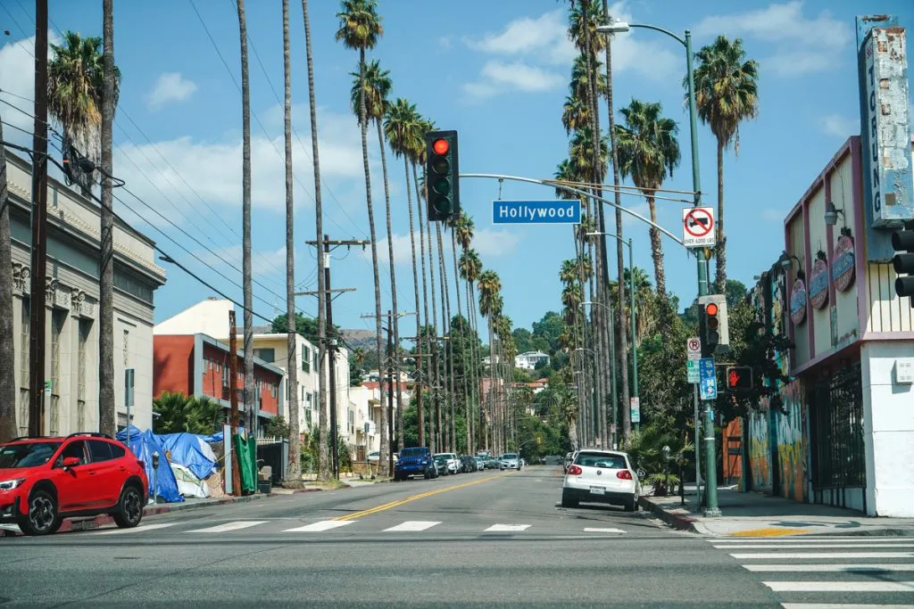
Los Angeles, CA

Slide 15
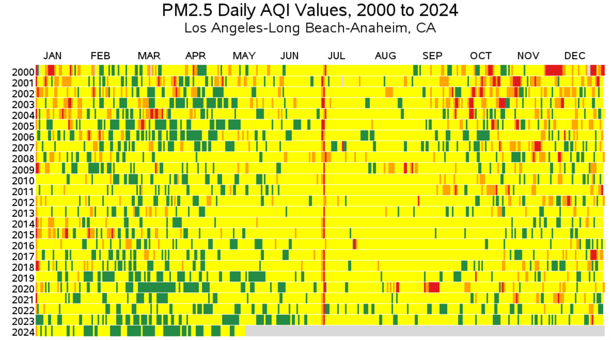
What do you notice?
What do you wonder?
Notes:
Teacher notes: You can ask students, what they think the red line down the center means? What happens in the USA at the beginning of July? What happens on July 4th? Why would fireworks change the air quality?

Slide 16
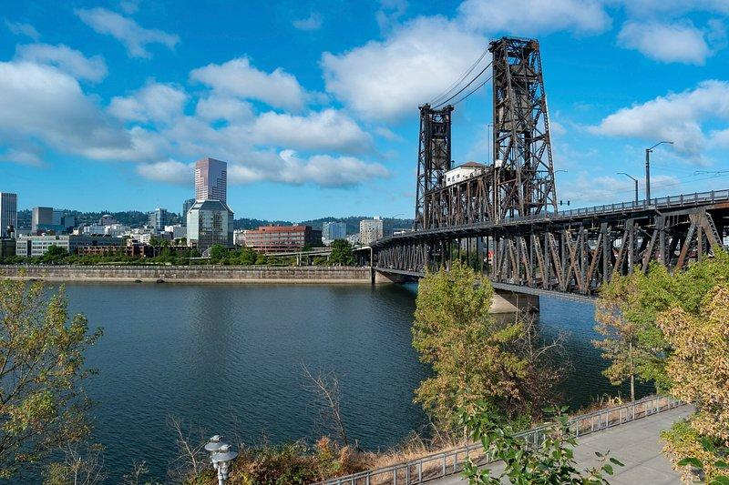
Portland, OR

Slide 17
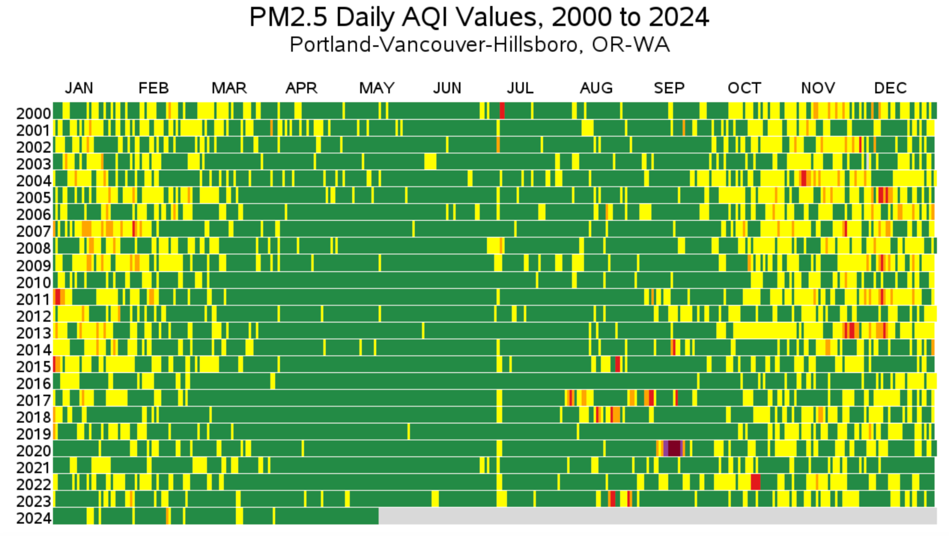
What do you notice?
What do you wonder?
Notes:
Teacher notes: You can ask students, what do you notice in August 2020? Do you remember what happened in Oregon in the summer of 2020?

Slide 18
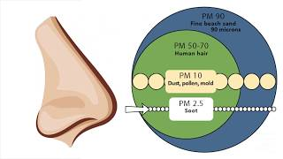
AQI Video
Why do we care about AQI?
Notes:
https://www.youtube.com/watch?v=zj4rd77EAt4 (1 minute)

Slide 19
What is Data Science?
The ability to derive meaningful information from data
Graphs, models, charts to make data easier to understand

Slide 20
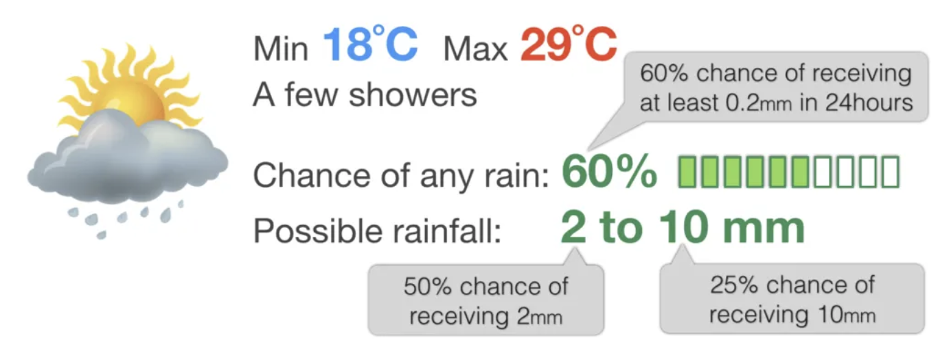
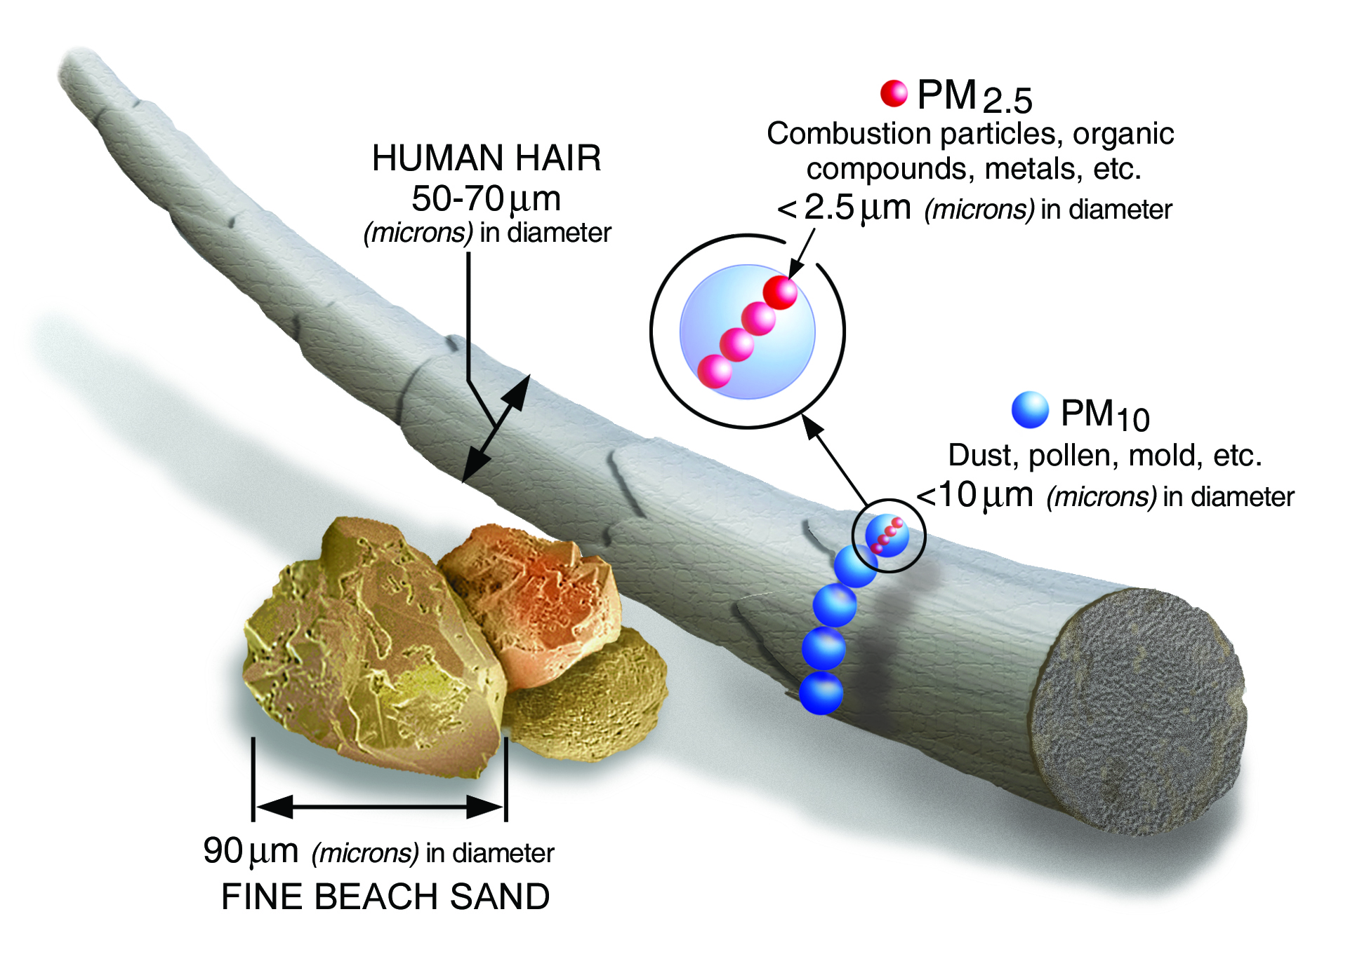
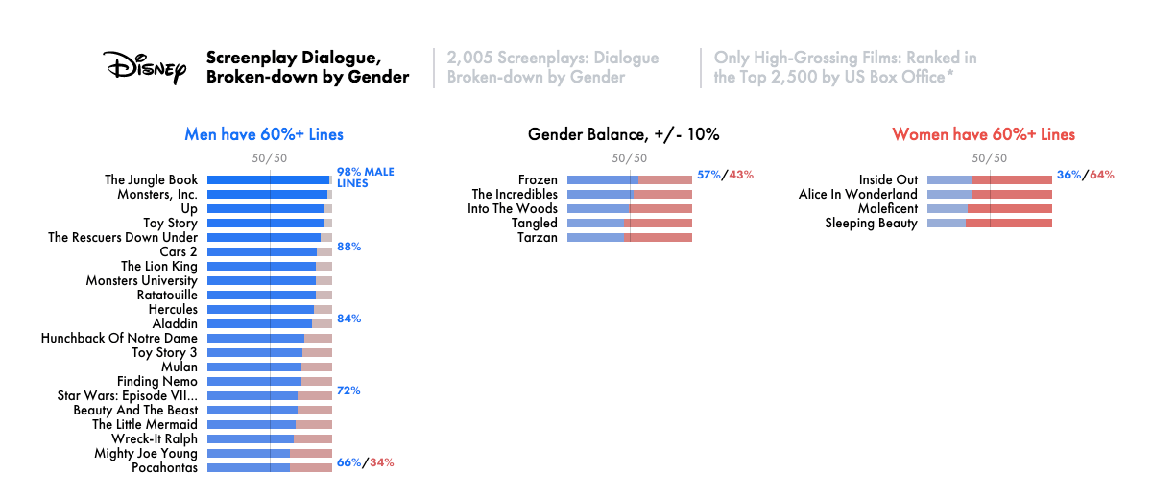

Slide 21
R Presentation
Here is how we can take data and organize it in a way that is easy to understand.
Demo here: Link to R Code
Notes:
https://drive.google.com/file/d/1Qf5qakeI5LUHL6nPp1wKjvFVGvdFI3gi/view?usp=sharing

Slide 22
Data Set from the EPA
The following data set has two spreadsheets: one measuring AQI in Portland and the other in Los Angeles. It has data that was collected nearly everyday for 23 years.
What do you notice? What conclusions can you draw?
EPA Data
Source: https://www.epa.gov/outdoor-air-quality-data/air-data-tile-plot

Slide 23
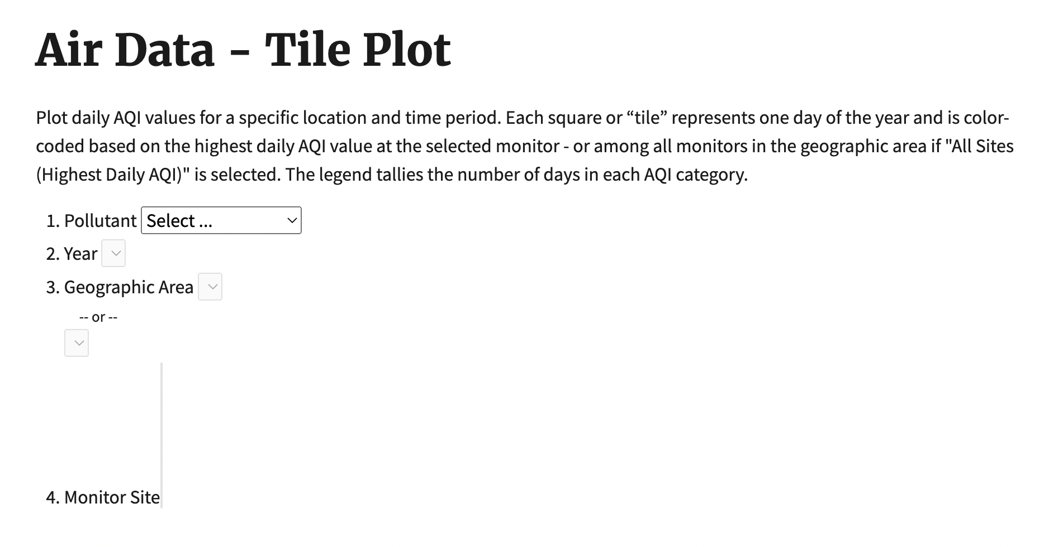
Try it yourself!

Slide 24
Data visualisation tells a story
Just by looking at the numbers, it can be hard to tell what the data is trying to tells us. There is a solution: Data visualization!
Using a graph where numbers are represented with lines is easier to understand.

Slide 25
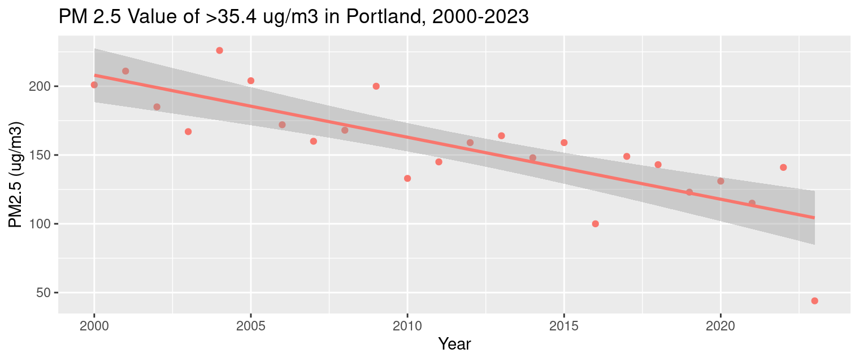
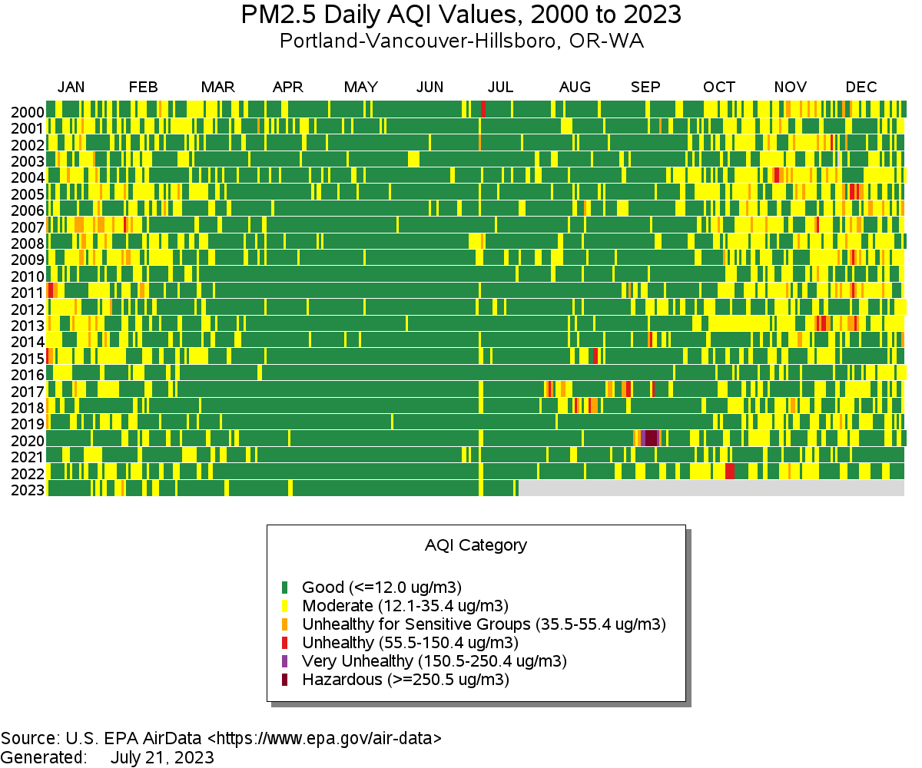
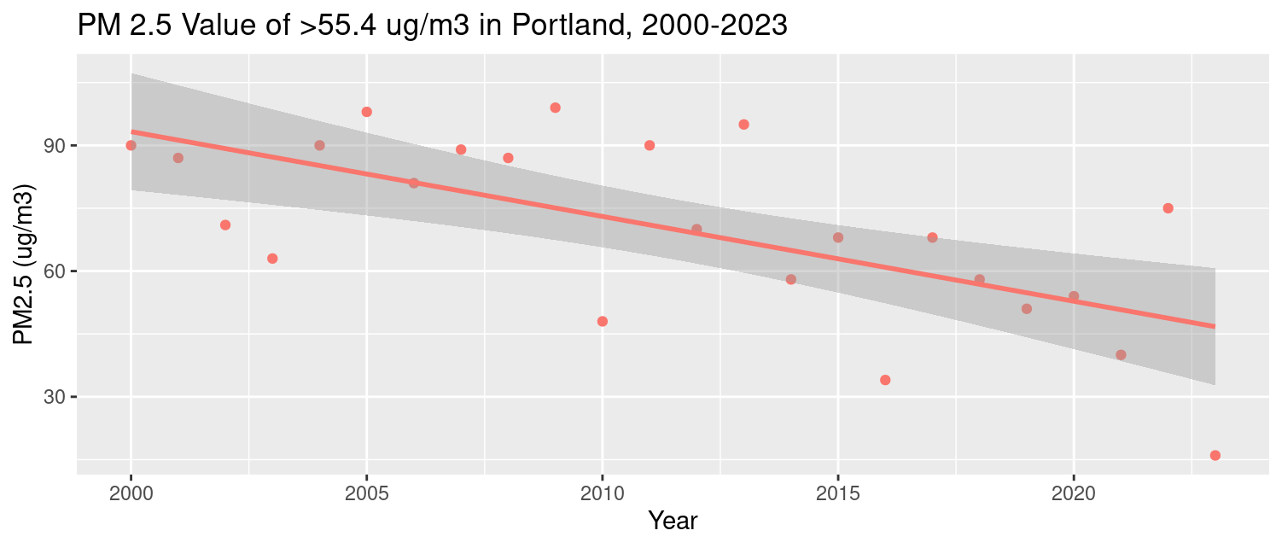
EPA visual of Particulate Matter 2.5
in Portland
Number of days per year where the PM 2.5 Value was above a certain threshold.

Slide 26
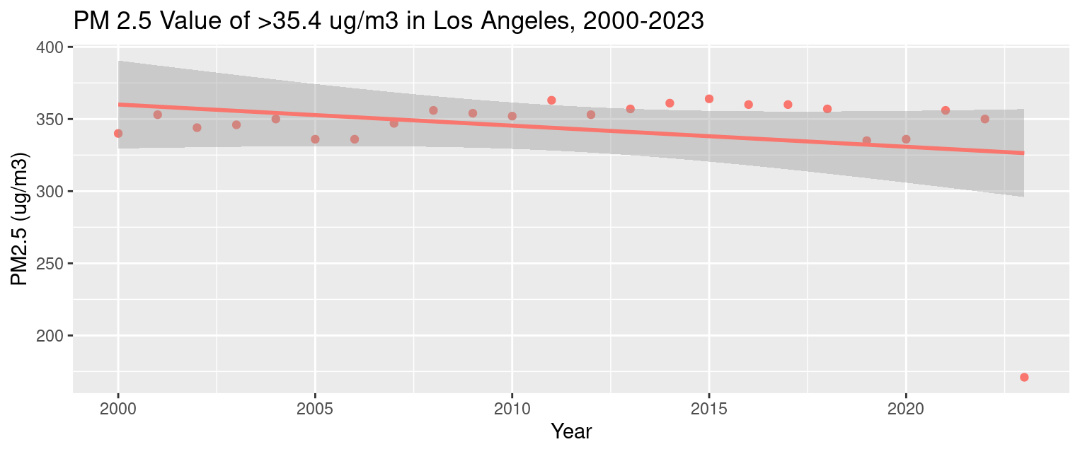
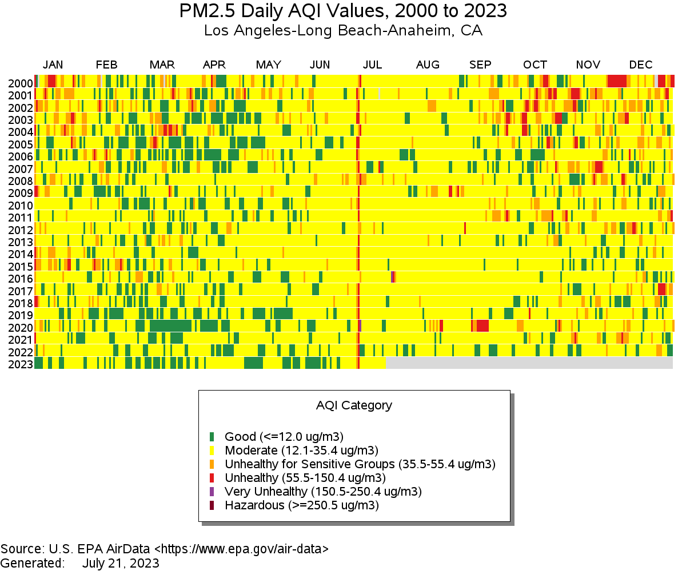
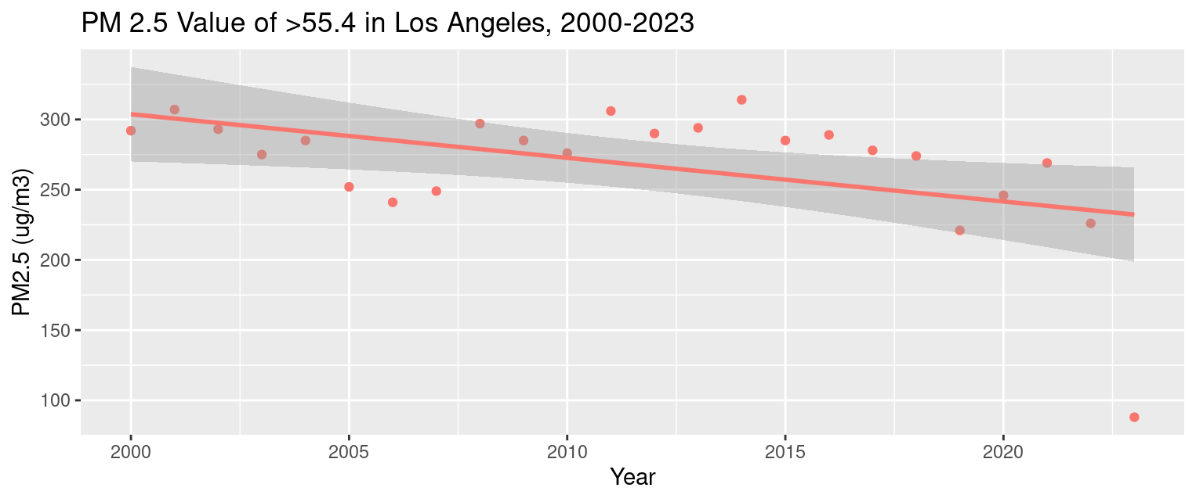
EPA visual of Particulate Matter 2.5
in Los Angeles
Number of days per year where the PM 2.5 Value was above a certain threshold.

Slide 27
When you see a graph, it’s important to look at the values and the kind of charts and ranges presented. The person who made the graph wants to tell you a story and you have to think critically about it.
A student at Lewis & Clark College took the raw data and made another tile plot using the same ranges and found a very different picture.

Slide 28
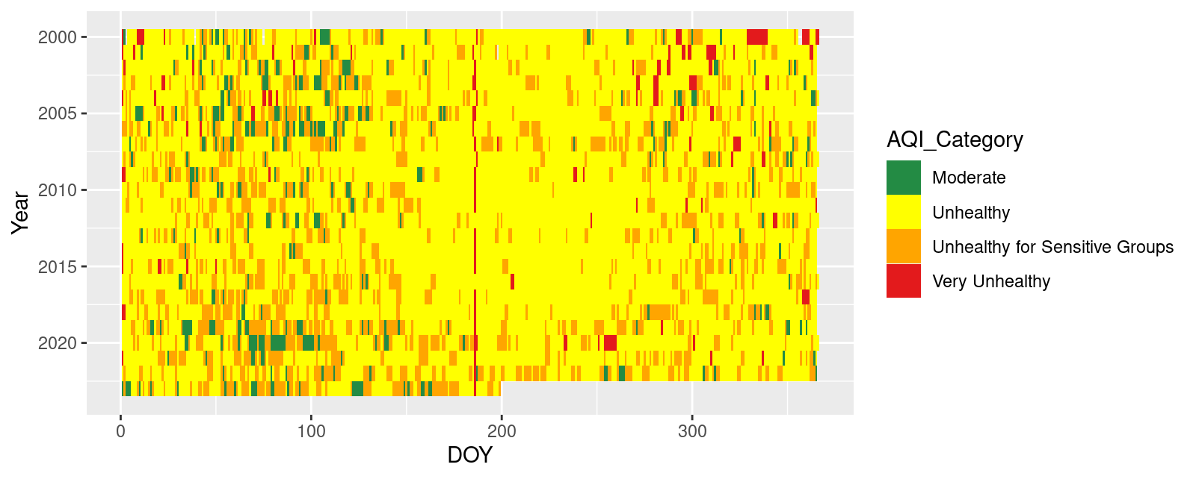
PDX accurate data

Slide 29
LA EPA Data
Let’s go back to the original LA graph made by the EPA software.
What do you think the accurate visualization will look like?

Slide 30
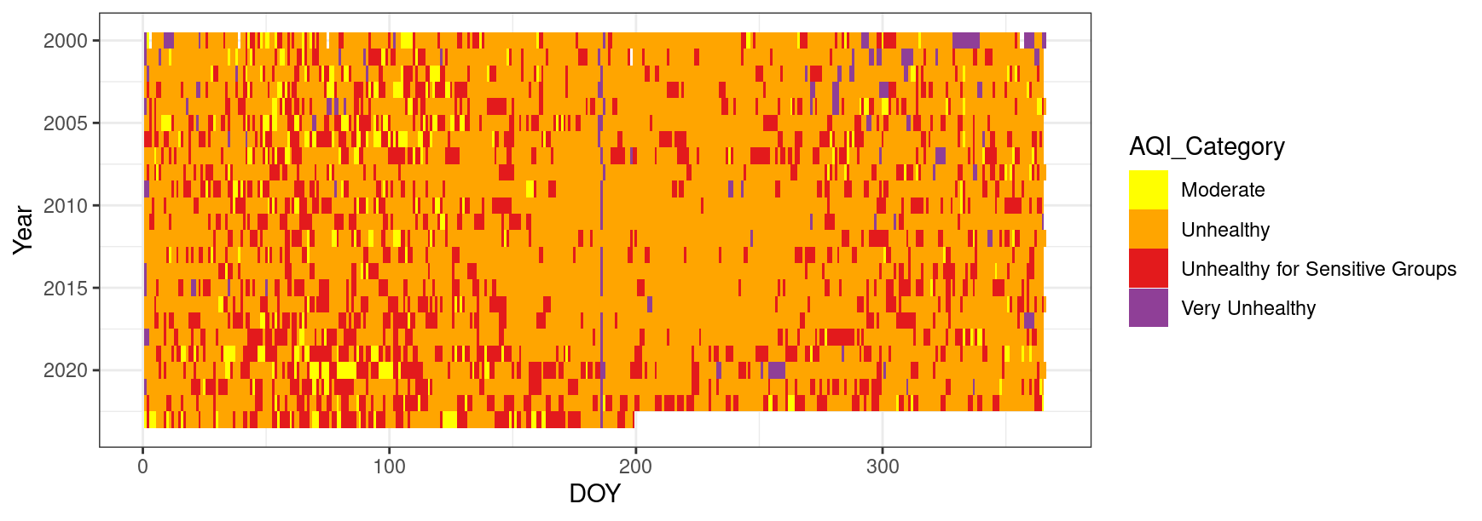
LA accurate data

Slide 31
Questions
If you were given the raw data, what other patterns would you like to look at?
Would you be interested in the AQI in other regions?
What questions do you have about data science or data visualization?

Slide 32
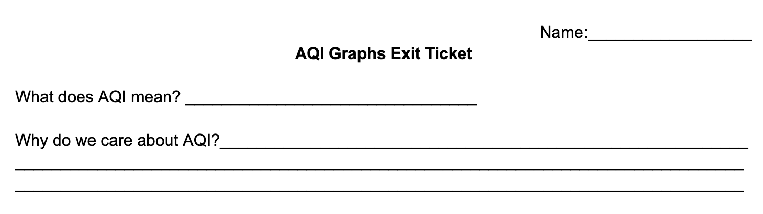
Exit Ticket
Notes:
AQI Exit Ticket

Slide 33

Wednesday
DAILY AGENDA
Warm up
CER Example
Argumentative Letter
Warm Up
What is this?
Planner:
Argumentative letter
Be Prepared
Sharpened pencil

Slide 34
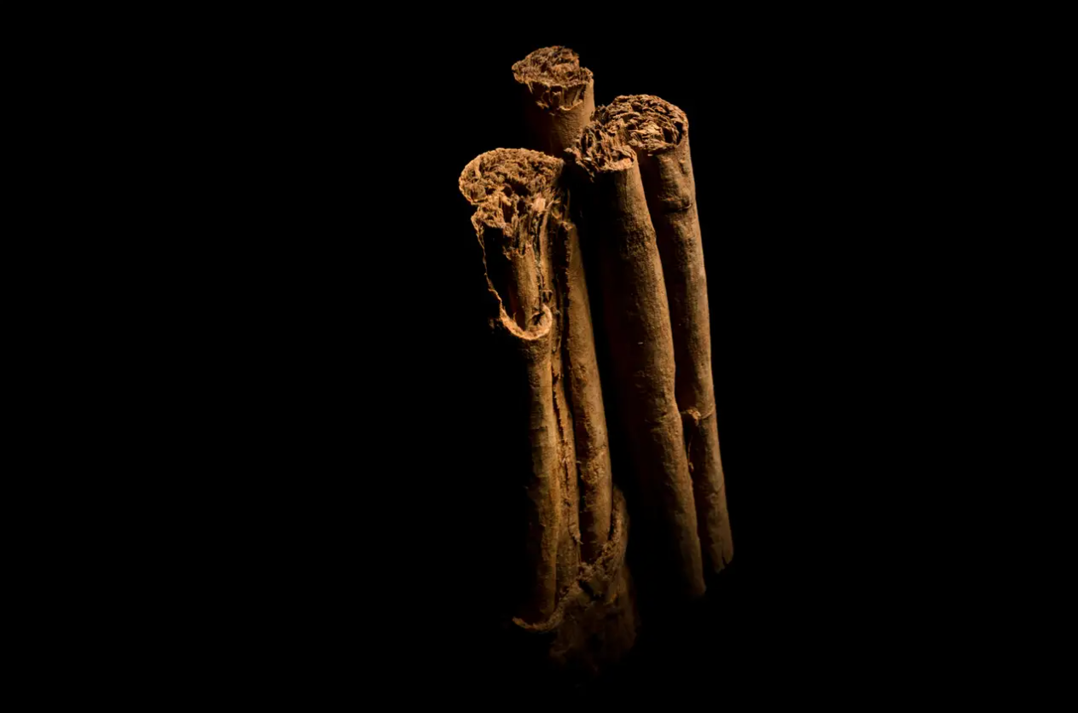
Cinnamon sticks

Slide 35
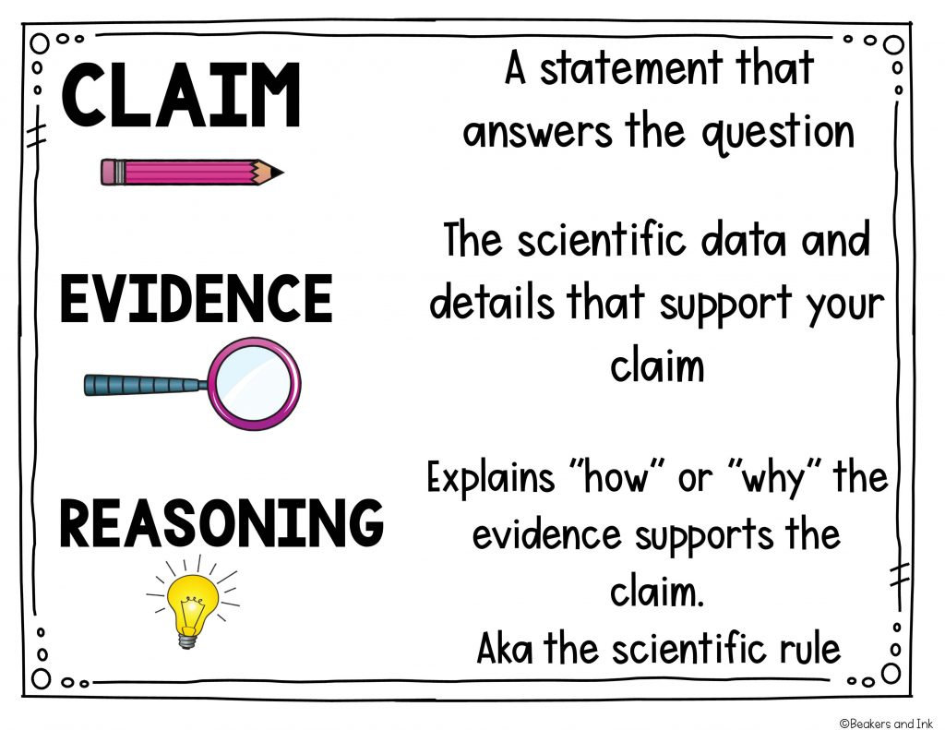

Slide 36

CER Example (5 MINUTES)
INSTRUCTIONS:
Watch the video (2 min 30 sec)
You will then make a CER in your notebook based on the video (2-3 min).
We will go over the CER as a class.

Slide 37
QUESTION: Should Spiderman get a driver's license?

Slide 38
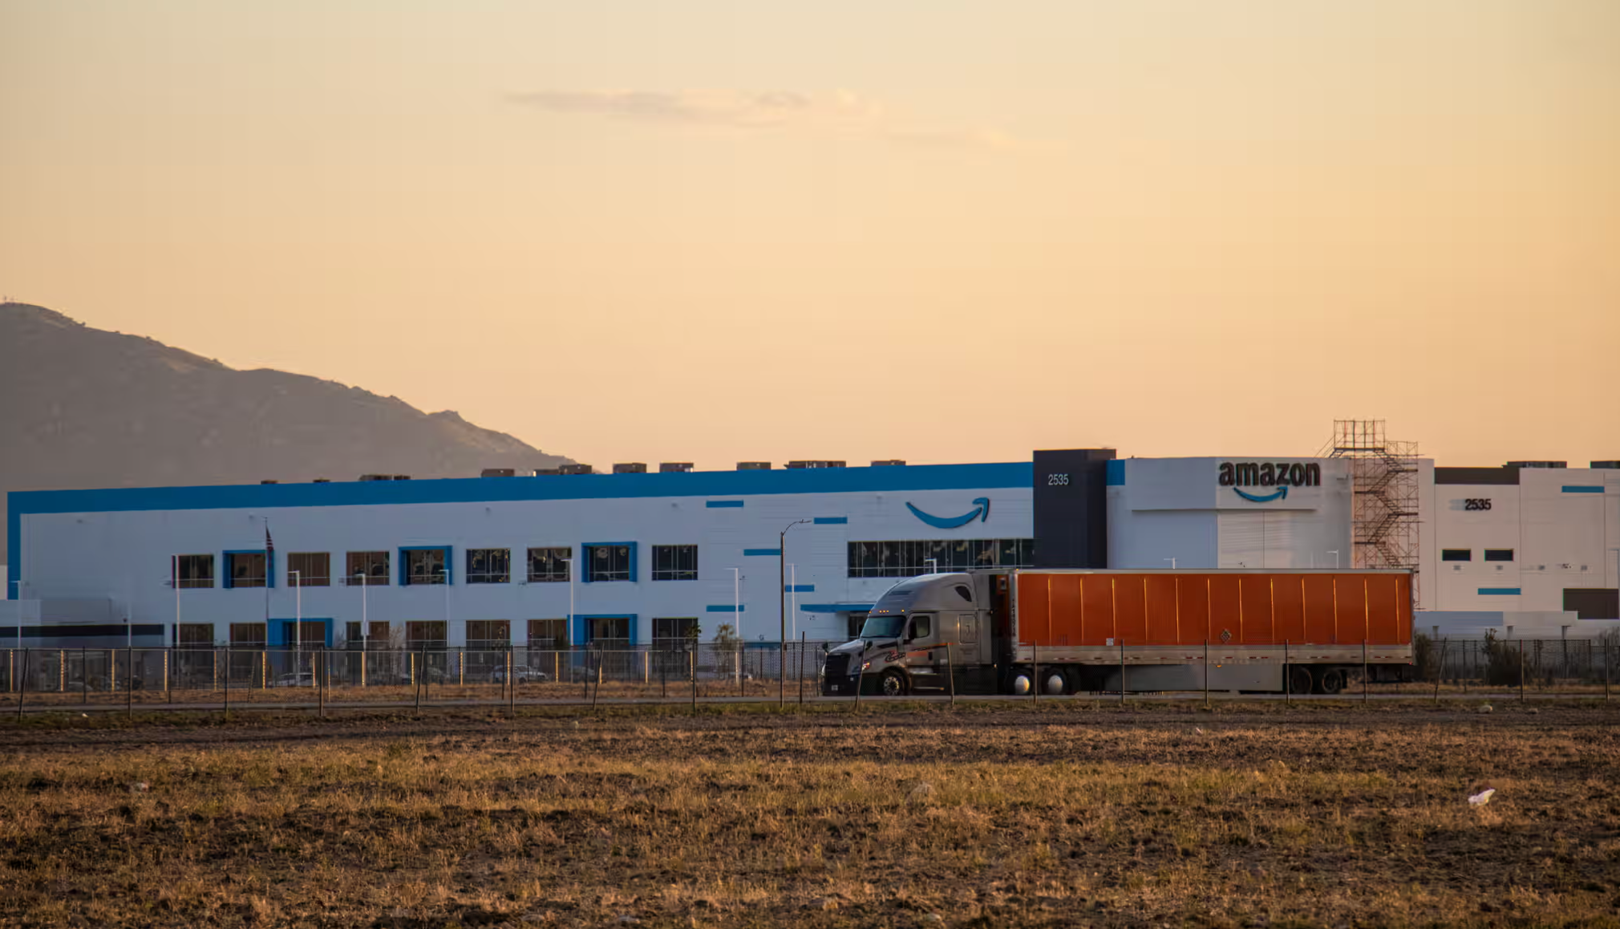


Truck Warehouse
Notes:
Guardian Article: Amazon’s warehouse boom linked…
Print ready Amazon article

Slide 39
QUESTION: Should the ProLogis company build a truck warehouse across the street from Parkrose Middle School?

Slide 40
QUESTION: Should the ProLogis company build a truck warehouse across the street from Parkrose Middle School?
Dear _______,
The parking lot next to Parkrose Middle School (should or should not) be developed into a truck warehouse.
Truck warehouses increase the AQI in the area. Based on the article…
The evidence shows that higher AQI is dangerous for kids with asthma.
Notes:
Go over CER here as a class.

Slide 41
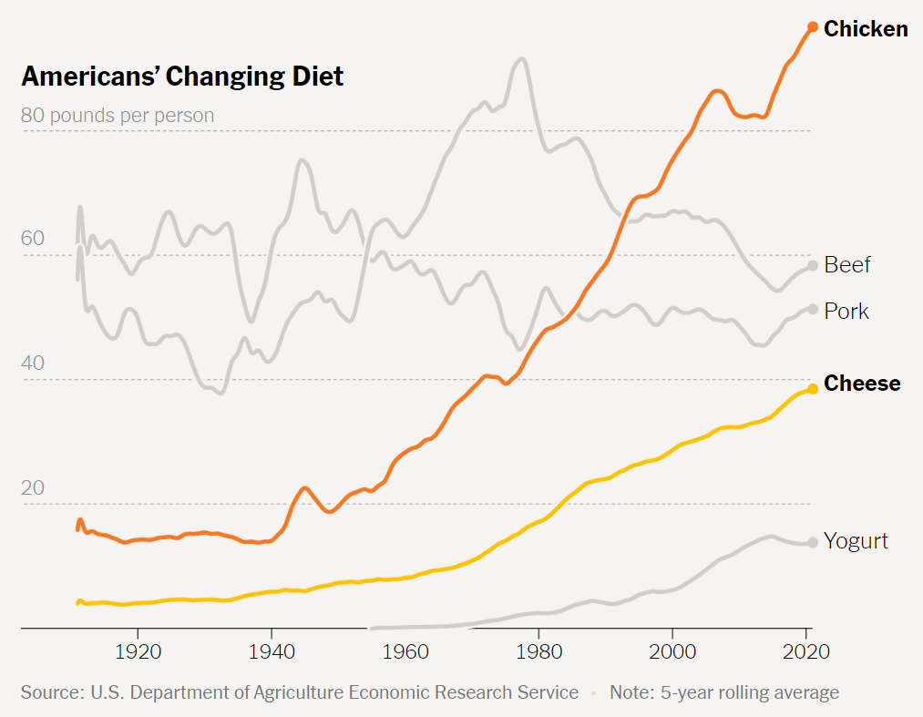
Thursday
DAILY AGENDA
Warm Up
Finish letter
Warm Up
What’s going on in this graph?
Planner:
Finish Argumentative letter
Be Prepared
Sharpened pencil
INB notebook

Slide 42
What do you notice?
“I notice that…”
What do you wonder?
“I wonder what…”
Create a catchy caption for this graph.
“Winner, winner, chicken dinner!”

Slide 43
QUESTION: Should the ProLogis company build a truck warehouse across the street from Parkrose Middle School?

Slide 44
QUESTION: Should the ProLogis company build a truck warehouse across the street from Parkrose Middle School?
Dear _______,
The parking lot next to Parkrose Middle School (should or should not) be developed into a truck warehouse.
Truck warehouses increase the AQI in the area. Based on the article…
The evidence shows that higher AQI is dangerous for kids with asthma.
Notes:
Go over CER here as a class.

